Slide 1
DCBA 3D Scanner
Low cost - High precision - User friendly
Notes:
Hello, we are team DCBA, developing affordable high precision 3D scanners.

Slide 2
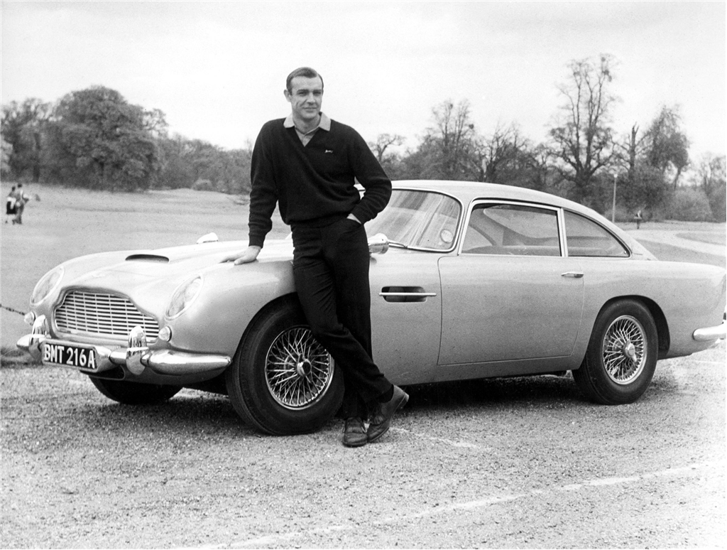
Notes:
Meet Sean. Sean collects classic cars, including his prized 1964 Aston Martin DB5, pictured here. However, during a routine checkup on this car, Sean noticed that several parts of the suspension were on the verge of failure and needed to be replaced. After perusing the internet and asking around at his local shop, he found that no one still manufactures the parts that he needed and that he was going to have to come up with his own solution. Fortunately, Sean has a 3D scanner. Sean was able to scan the failing parts with his 3D scanner to obtain a 3D model and send the files off to a company that does metal die-casting. Two weeks later he received his parts in the mail and his car is as good as new, ready to (ehem) die another day, if you will.

Slide 3
3D scanners should be a standard piece of equipment in every studio, workshop, and lab.
Notes:
That was one specific case, but there are many more applications for 3D scanning. For starters, 3D scanners have the analogous capabilities of their 2D counterparts. A 3D scanner can be used to catalogue an object for later use or, when coupled with a 3D printer, be used to make replicas of an existing object. However, 3D scanners also have the potential to revolutionize art, product design, and manufacturing as they allow for seamless transition between the physical world and the digital world.
At the moment, 3D scanners that exceed machining and 3D printing precision are too expensive to be accessible to most potential users. Case in point, the cheapest option offered by one of our competitors costs $3000 dollars. This is what sets us apart. We achieve our vision of making 3D scanners a standard piece of equipment by bringing the cost of high-precision 3D scanners down to $500.

Slide 4
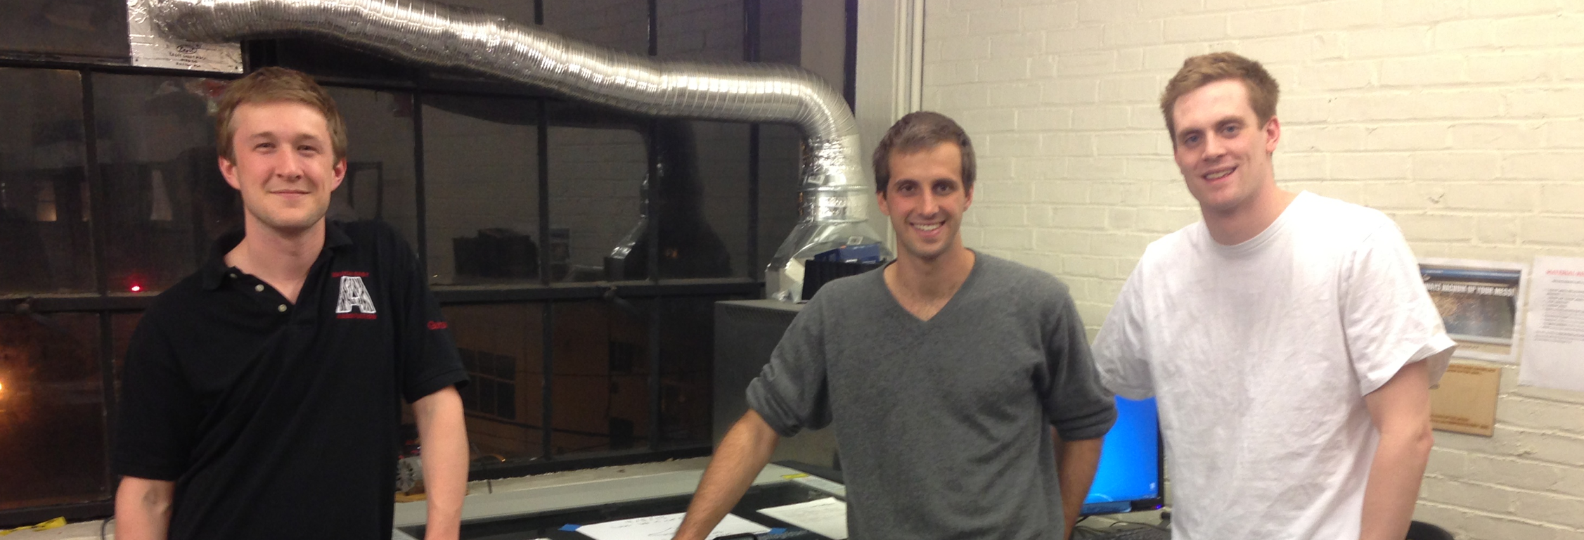
Team + Skill set
Gus Downs: Optics and signal processing
Troy Astorino: Programming and probabilistic robotics
Craig Cheney: Mechanical engineering and embedded systems
Notes:
Gus: This is our team. My name is Gus. My background is in experimental laborartory physics and through this work I’ve gained a significant amount of experience working with table top optics and signal processing for data collection. During my sophomore year I built and designed a novel new Ultrafast electron diffraction experiment for studying utrafast processes in quantum materials, and just this past summer I was funded by the NSF to do research at the top atomic and optical physics institution in the world.
Troy:
Craig: I’m Craig, my background is in Mechanical engineering and Controls. I’ve been doing mechanical design and robotics since High school, and this last semester I won Most Valuable Engineer in the Robo-Gymnastics competition, as part of MIT’s 2.12 Intro to Robotics.

Slide 5
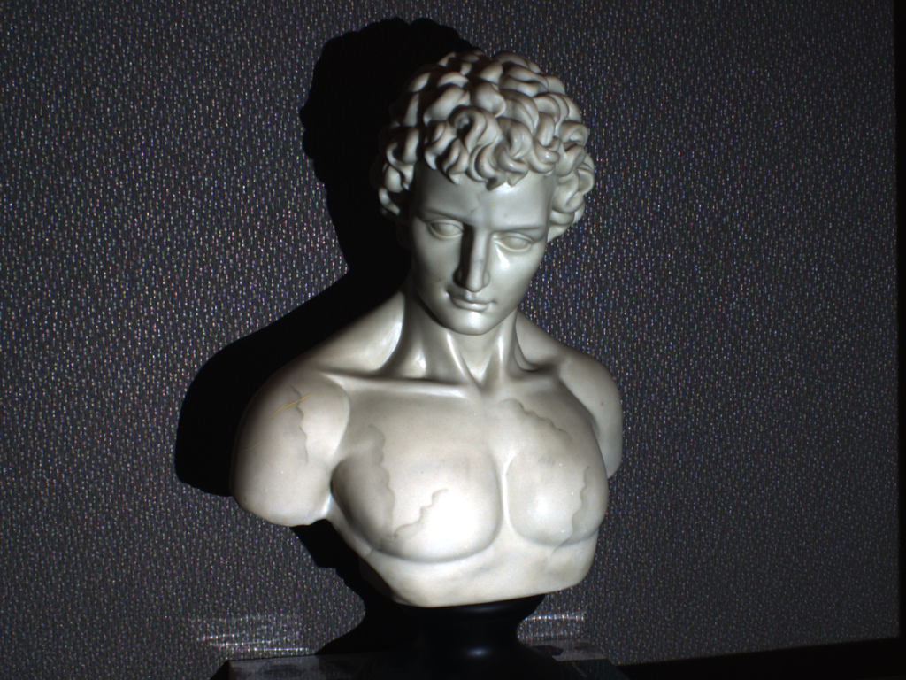
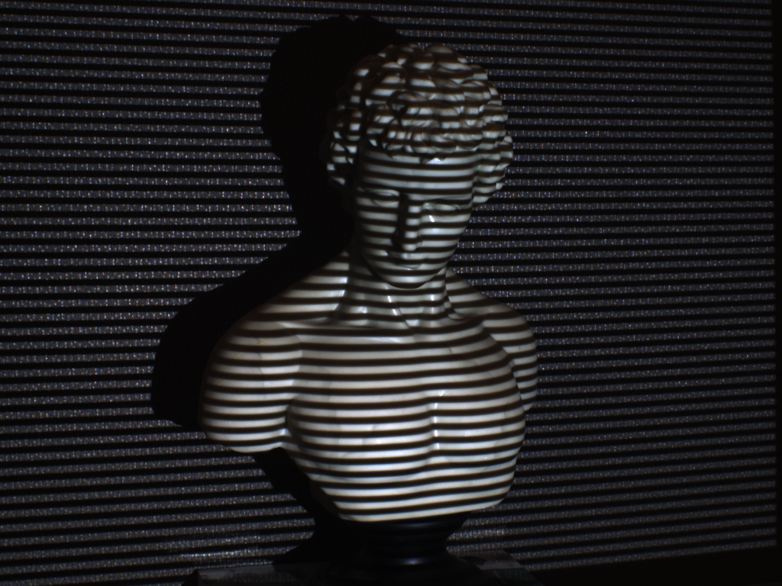
Technical Approach
Structured light scanning
Clever approach to hardware ➛ reduce cost substantially
Notes:
For the scanning itself, we are using a technique called structured light scanning. This method has been popular in an academic setting and we plan on bringing it to commercialization.
Gus’ background in physics and optics and my background in mechanical design and embedded systems will allow us to use inexpensive components in clever ways to drive down our cost per unit by an order of magnitude. Additionally the work that Troy and I have done in robotic systems provides us with the experience to mitigate noise from our sensors. We know that design for manufacturability as well as ease of use are key components to making us successful.

Slide 6
Product Goals
Intuitive, clean software interface
.025mm scan accuracy
< 5 minute scan time
1 ft³ scan volume
$500 price point
Plug and Play

Slide 7


Open Source Libraries

Slide 8
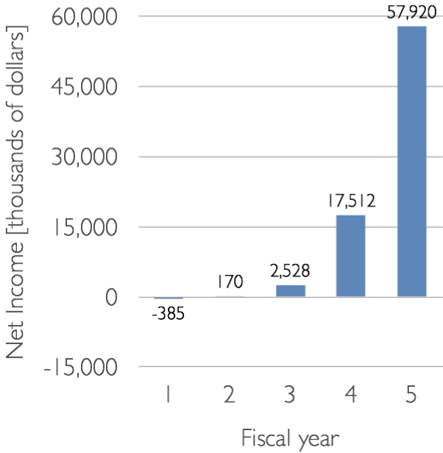
Market
Traditional scanning: $5B
Industrial 3D scanning: $530M

Slide 9
Components List
Component | Cost | Quantity
Stepper motor | $12.95 | 1
Bearing | $4.44 | 1
Camera Sensor | $7.89 | 3
5W Laser | $17.77 | 1
6mm FL lens | $38.00 | 1
Microprocessor, board, wiring | $15.00 | –
Structure, housing | $35.00 | –
Total: $146.83

Slide 10
Summer Plans
Committed full-time
Looking for money, space to prototype, mentorship, community of entrepreneurs

Slide 11
DCBA
Affordable, accurate 3D scanner
Technically accomplished team
Passionate about our product
Notes:
With that, we’d like to field any questions that you may have for us.

